Slide 1
DAA
Prepared by
Dr.S.Jenicka
Associate professor senior grade 1
SCOPE-Analytics
VIT Vellore

Slide 2
Traveling salesman problem
A graph is made up of vertices (also called nodes) which are connected by edges.
A walk with no repeated edges is called a tour.
A non-empty trail in which the only repeated vertices are the first and last vertices is called cycle
A Hamiltonian circuit is defined as a cycle that passes through all the vertices of the graph exactly once.
TSP : The problem asks to find the shortest tour through a given set of n cities that visits each city exactly once before returning to the city where it started.
Difference between TSP and Hamiltonian circuit: In TSP we look for the shortest path that visits all cities exactly once but in Hamiltonian circuit we just look for a path that visits all vertices in the graph exactly once.

Slide 3
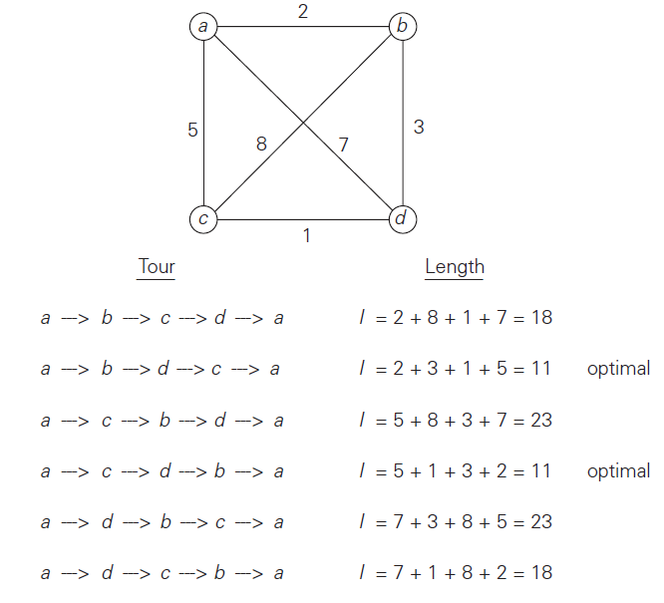
Brute force solution-TSP

Slide 4
Runtime complexity of TSP –Brute force
Brute force explores all permutations of ‘n’ locations and so the runtime complexity is O(n!).

Slide 5
Divide and conquer
Divide-and-conquer algorithms work according to the following general plan:
A problem is divided into several subproblems of the same type, ideally of about equal size.
The subproblems are solved (typically recursively, though sometimes a different algorithm is employed, especially when subproblems become small enough).
If necessary, the solutions to the subproblems are combined to get a solution to the original problem.

Slide 6
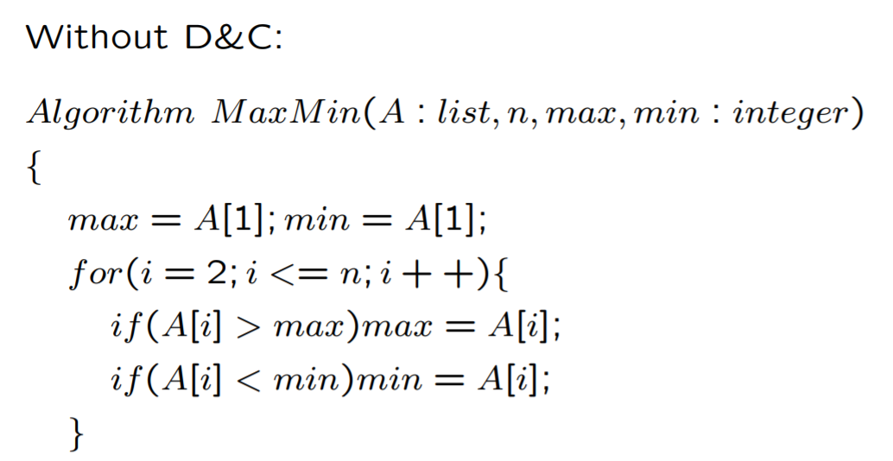
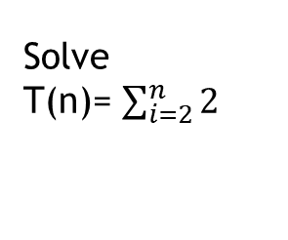
Minmax Algorithm -iterative
Solve
T(n)= $\sum_{i=2}^{n}{2}$

Slide 7
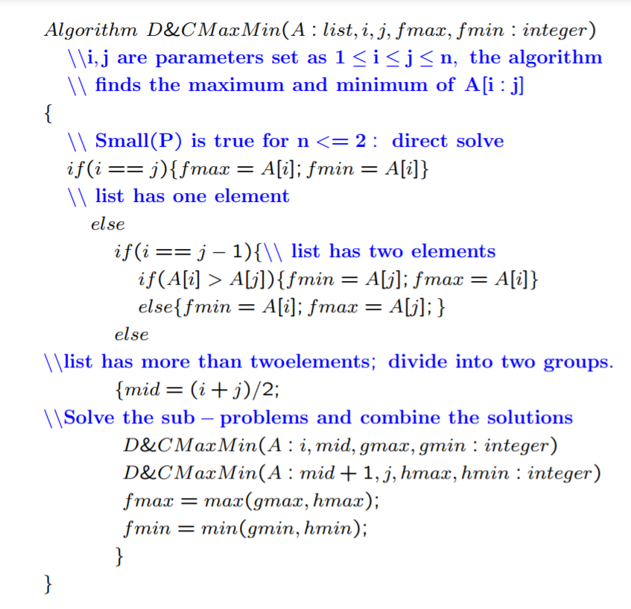
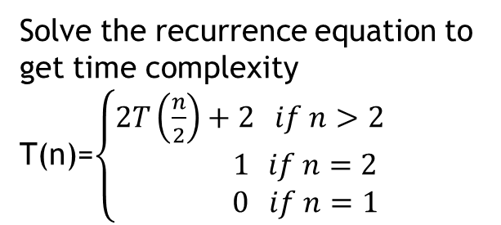
Minmax Algorithm –Divide and conquer
Solve the recurrence equation to
get time complexity
T(n)=$\left\{\begin{aligned}2T\left(\frac{n}{2}\right)+2 if n>2 \\ 1 if n=2 \\ 0 if n=1\end{aligned}\right.$

Slide 8
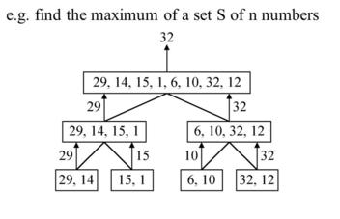
Note: When I have found max min values deep down to the left and right subtrees, I have to merge the results using fmax=max(gmax, hmax) and fmin=min(gmin, hmin). Now gmax and gmin are the results obtained from left subtree containing (29,14) and hmax and hmin are the results obtained from right subtree containing (15,1)
29,14,15,1,6,10,32,12
29,14,15,1
29,14 (gmax=29,gmin=14)
15,1(hmax=15, hmin=1) // Goes one step above and explores RST
Merge (fmax=29, fmin=1)----------1
6,10,32,12 //Reaches root and explores the RST
6,10 (gmax=10, gmin=6)
32,12 (hmax=32, hmin=12) // Goes one step above and explores RST
Merge (fmax=32, fmin=6)----------2
Final merge of -1- and -2- (fmax=32, fmin=1)

Slide 9
Greedy strategy
The greedy approach suggests constructing a solution through a sequence of steps, each expanding a partially constructed solution obtained so far, until a complete solution to the problem is reached. On each step the choice made must be:
feasible, i.e., it has to satisfy the problem’s constraints locally optimal,
i.e., it has to be the best local choice among all feasible choices available on that step and
irrevocable, i.e., once made, it cannot be changed on subsequent steps of the algorithm
Note: it suggests a “greedy” grab of the best alternative available

Slide 10
Greedy approach in Knapsack problem
The idea of the greedy approach is to calculate the ratio value/weight for each item and sort the item on basis of this ratio. Then take the item with the highest ratio and add them until we can’t add the next item as a whole and at the end add the next item as much as we can. Which will always be the optimal solution to this problem.

Slide 11
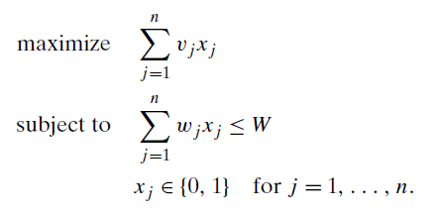
0/1 knapsack problem
0/1 knapsack problem : Given n items of known weights w1, w2, . . . , wn and values v1, v2, . . . , vn and a knapsack of capacity W, find the most valuable subset of the items that fit into the knapsack.

Slide 12
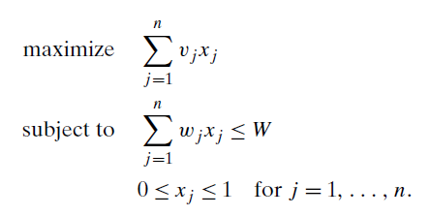
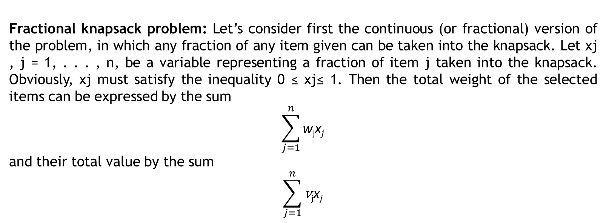
Fractional knapsack problem
Fractional knapsack problem: Let’s consider first the continuous (or fractional) version of the problem, in which any fraction of any item given can be taken into the knapsack. Let xj , j = 1, . . . , n, be a variable representing a fraction of item j taken into the knapsack. Obviously, xj must satisfy the inequality 0 ≤ xj≤ 1. Then the total weight of the selected items can be expressed by the sum
$$\sum_{j=1}^{n}{\text{w}\text{j}\text{x}j}$$
and their total value by the sum
$$\sum_{j=1}^{n}{\text{v}\text{j}\text{x}j}$$

Slide 13
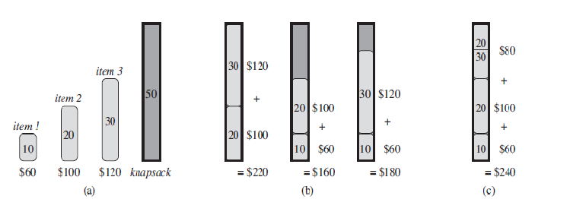
Example
Item | Weight | Value | Value/Weight
1 | 10 | 60 | 6
2 | 20 | 100 | 5
3 | 30 | 120 | 4
Fractional Knapsack problem
0/1 Knapsack problem

Slide 14
Runtime complexity
Runtime complexity of fractional knapsack using Greedy strategy is O(nlogn) as sorting requires O(nlogn) time.

Slide 15
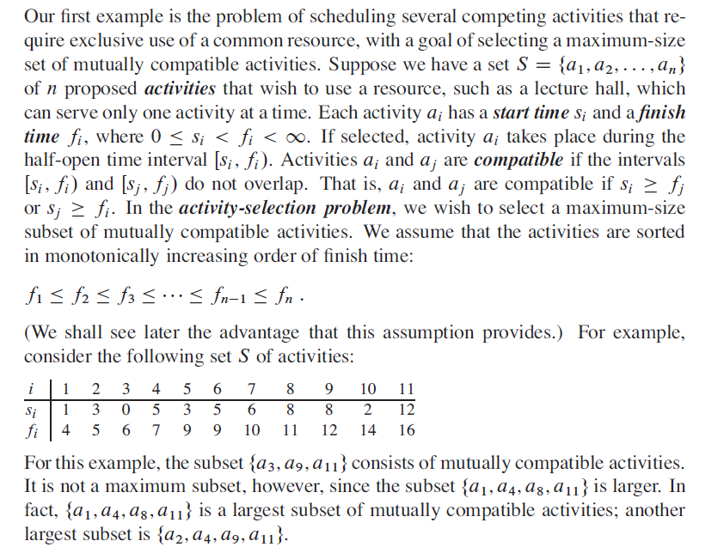
Activity selection problem

Slide 16
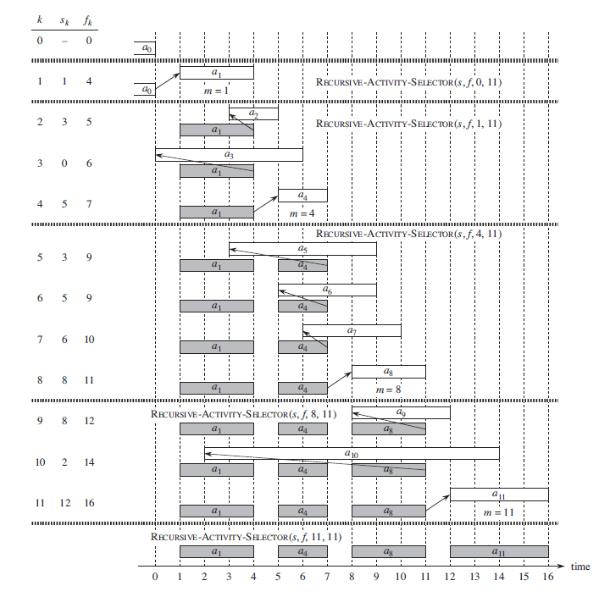
Tracing the algorithm

Slide 17
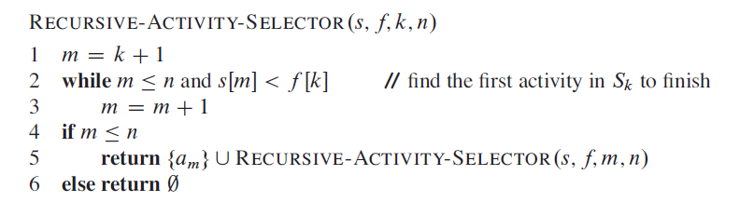
Activity selection algorithm

Slide 18
Runtime complexity
Runtime complexity of activity selection algorithm using Greedy strategy is O(nlogn) when the array is not sorted.

